Slide 1
CPE 404
Computer Hardware Design
Dr Osama Hosameldeen
Spring 2021
Lecture 13
Memory Systems – Static RAM

Slide 2
Topics
Random Access Memory
  Static RAM (SRAM)
  Array of RAM ICs
  Dynamic RAM (DRAM)
  Types of Dynamic RAM
Comparison (SRAM vs. DRAM)
Expanding Memories
  Extend Width
  Extend Capacity
Notes:
School of Engineering

Slide 3
Computers & Memory

Slide 4
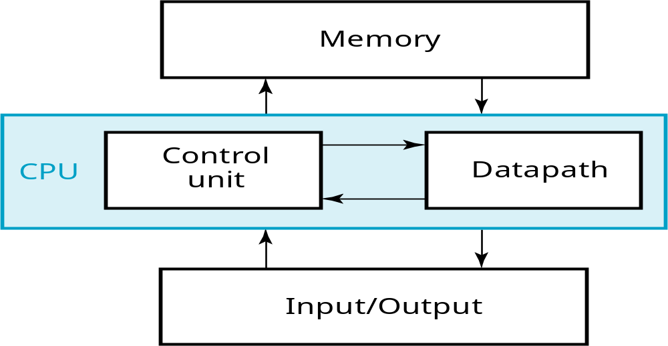
A Digital Computer System
Data/Instructions/code
clock
Inputs: Keyboard, mouse, modem, microphone
Outputs: CRT, LCD, modem, speakers
Notes:
School of Engineering
Answer: Part of specification for a PC is in MHz. What does that imply? A clock which defines the discrete times for update of state for a synchronous system. Not all of the computer may be synchronous, however.

Slide 5
Memory: Introduction

Slide 6
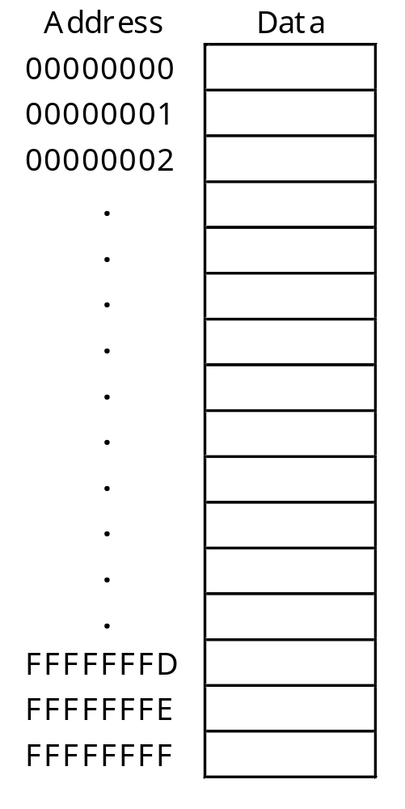
Picture of Memory
16-bit/32-bit
You can think of memory as being one big array of data.
  The address serves as an array index.
  Each address refers to one word of data.
You can read or modify the data at any given memory address, just like you can read or modify the contents of an array at any given index.
Word

Slide 7
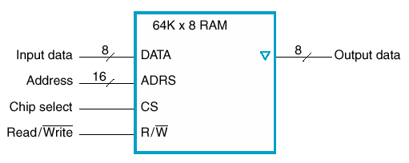
Memory Signal Types
Memory signals fall into three groups
  Address bus - selects one of memory locations
  Data bus
    Read: the selected location’s stored data is put on the data bus
    Write (RAM): The data on the data bus is stored into selected locations
  Control Signals - specifies what the memory is to do
    Control signals are usually active low
    Most common signals are:
      CS: Chip Select; must be active to do anything
      OE: Output Enable; active to enable data to appear on the bus
      WR: Write; active to write data to memory
      R: Read; active to read data from memory
      Or a single R/W line

Slide 8
Properties of Memory
Volatile: Memory contents disappears if power turned off, found in:
    Typical computer systmes (laptops, desktops)
    PDA, Smart Phone, iPADs, …
Nonvolatile: Contents of memory remain even if power turned off, found in:
    Smart Phones,
    Hard Drives,
    Memory Sticks

Slide 9
RAM vs. ROM
Volatile Memory
  RAM (Random Access Memory)
    Static RAM usually used for Cache
    Dynamic RAM used for Main Memory
Non-Volatile Memory
  ROM (Read Only Memory),
    EPROM
    EEPROM
    FLASH
    Used to store permanent programs in a computer system (booting), bit stream of FPGA

Slide 10
Classification

Slide 11
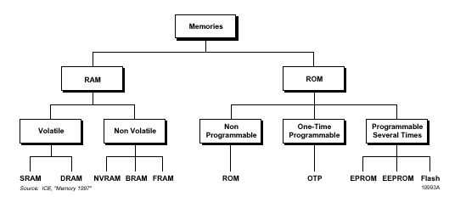
Classification of Memory

Slide 12
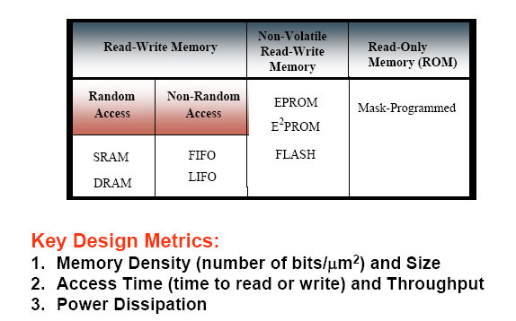
Key Design Metrics

Slide 13
Memory Technologies
The access time and price per bit vary widely among these technologies, as seen in the table below.
Memory Technology | Typical Access time | $ per GIB in 2012
SRAM Semiconductor memory | 0.5 – 2.5 ns | $500 - $1000
DRAM Semiconductor memory | 50-70 ns | $10 - $20
Flash Semiconductor memory | 5,000 – 50,000 ns | $0.75 - $1.00
Magnetic Disk | 5,000,000 – 20,000, 000 ns | $0.05 - $0.10
In this course we will cover the basics of:
  Static RAM (SRAM)
  Dynamic RAM (DRAM)

Slide 14
Memory Hierarchy
The design constraints on a computer memory can be summed up by three questions (i) How Much (ii) How Fast (iii) How expensive.
There is a tradeoff among the three key characteristics
A variety of technologies are used to implement memory system
Dilemma facing designer is clear → large capacity, fast, low cost!!
Solution → Employ memory hierarchy
Flip Flops
Cost
Registers
Static RAM
Cache
Capacity
Dynamic RAM
Main Memory
Disk Cache
Access
Time
Magnetic Disk
Removable Media
Secondary Storage

Slide 15
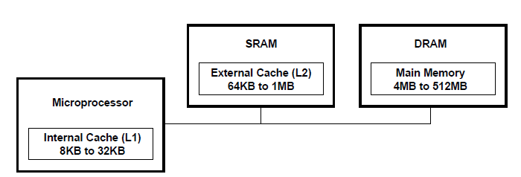
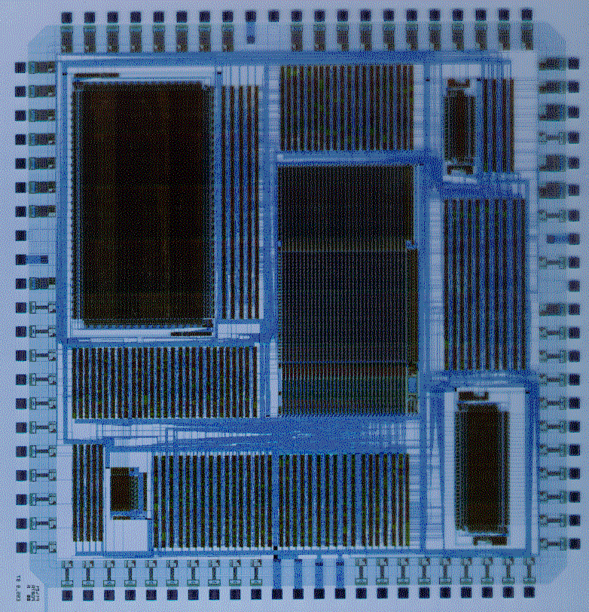
Main Memory vs. Cache
Dynamic RAM
Static RAM
Registers
(Flipflops)
Static RAM

Slide 16
Bus/Memory Hierarchy
Registers
Static RAM
CPU
Dynamic RAM
Cache
Controller
Cache
Memory
Local CPU / Memory Bus
PCI
Controller
DRAM
Co-processor
Peripheral Component Interconnect Bus
EISA/PCI Bridge
Controller
Hard Drive
Controller
Video
Adaptor
SCSI
Adaptor
EISA PC Bus
SCSI
Bus
PC Card 1
PC Card 2
PC Card 3

Slide 17
RAM vs. ROM
RAM
  Read/write
  Volatile
  Faster access time
  Variants
    SRAM
    DRAM
  Application
    Variables
    Dynamic memory allocation
    Heaps, stacks
ROM
  Read only
  Non-Volatile
  Slower
  Variants
    PROM,EPROM
    EEPROM, FLASH
  Application
    Programs
    Constants
    Codes, e.t.c

Slide 18
Random Access Memory

Slide 19
Random Access Memories
So called because it takes the same amount of time to address any particular part
Types of RAM
  Static RAM (SRAM), fast, expensive
  Dynamic RAM (DRAM), slow, cheap
How is memory accessed?
  Address Lines, Data Lines
  Control Signals (R/W, chip select, …)

Slide 20
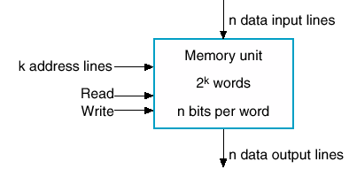
Simple View of RAM
Of some word size n = 4,8,16,32,64 ….
  n-bit data input lines
  n-bit data output lines
Some capacity 2^{k}
  k bits of address line, k=10,11,..
Has a read line
Has a write line

Slide 21
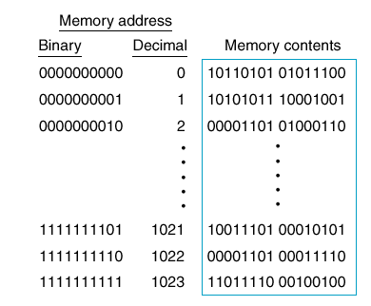
1K x 16 memory
Variety of sizes
  From 1-bit wide
Issue is no. of pins
Memory size specified in bytes
  1K x 16 bit → 2KB memory
10 address lines and 16 data lines
1024 words
16-bit

Slide 22
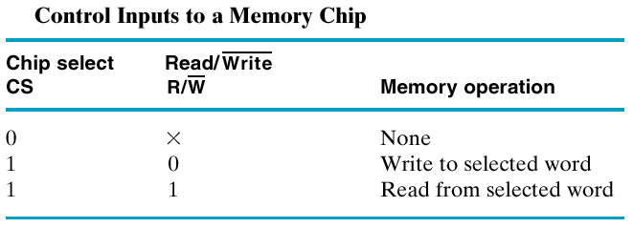
Chip Select and R/W Lines
R/W Lines enable reading/writing
Usually a chip select line is used.
Why?
  To enable RAM chip to be accessed.
  Tri state capability

Slide 23
Memory: Writing
Sequence of steps
  Setup address lines
  Setup data lines
  Activate write line (maybe a positive edge)
The write cycle time is the maximum time from the application of the address to the completion of all internal memory operations required to store a word.

Slide 24
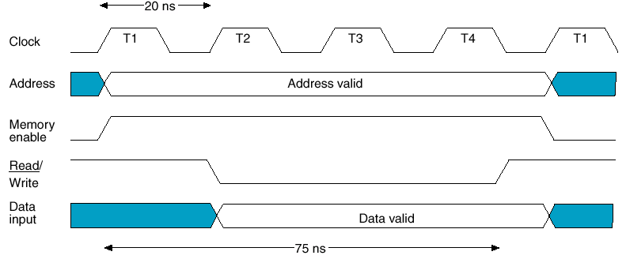
Writing: Timing Waveforms
CPU operates at 50 MHz (20 ns)
4 clock cycles to perform a write

Slide 25
Memory Reading
Steps:
  Setup address lines
  Activate read line
  Data available after specified amount of time
Read cycle usually is shorter than write cycle.

Slide 26
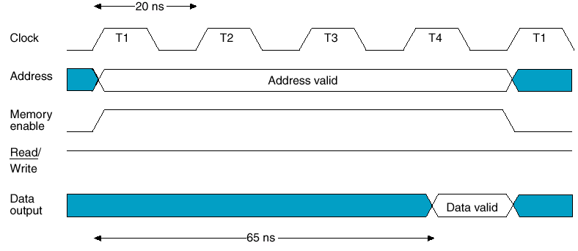
Memory Waveform: Reading
CPU operates at 50 MHz (20 ns)
65 ns required for a read cycle

Slide 27
Static RAM

Slide 28
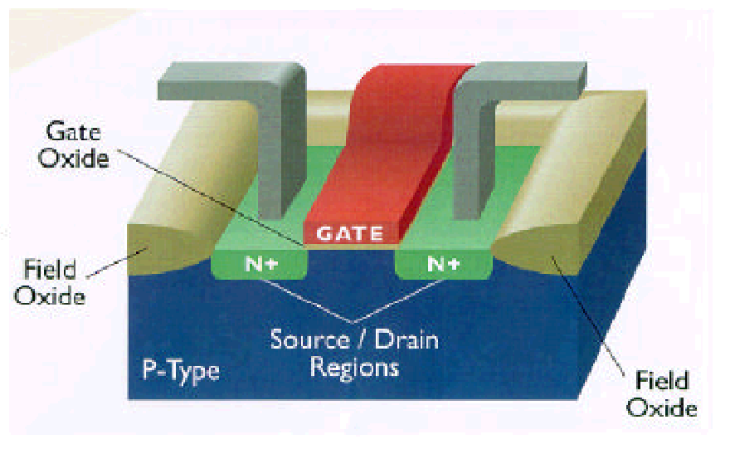
MOSFET: Metal Oxide
Semiconductor
Field Effect Transistor
A voltage controlled device
Dissipates less power
Achieves higher density on an IC
Has full swing voltage 0 → 5V

Slide 29
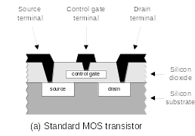
nMOS Transistor
An nMOS Transistor
I_{ds}
|V
GS
|
V_{gs}

Slide 30
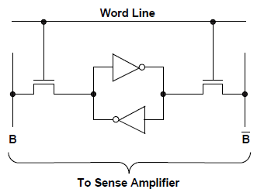
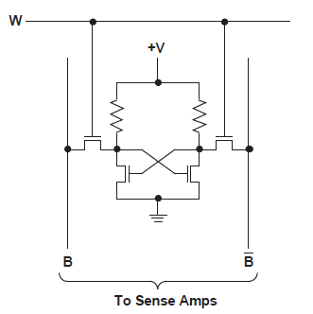
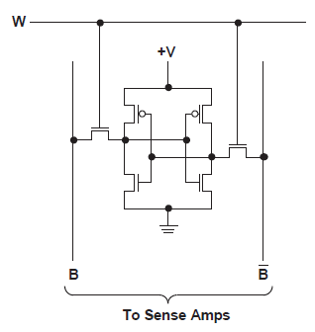
Static RAM: 4T and 6T
Six Transistors to implement a memory cell

Slide 31
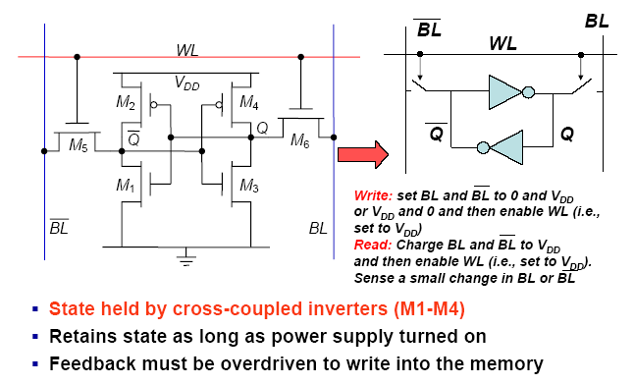
SRAM Cell
VDD
VDD
VDD
GND
VDD
Word Line
Bit Line

Slide 32
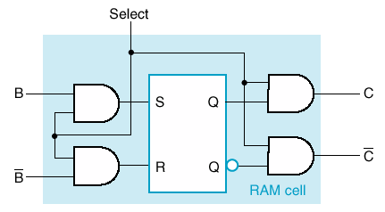
Simplify Modeling using Latch
Storage is modeled by an SR latch.
Control logic
One memory cell per bit
If select = 0, the stored content is held.
If select = 1, the stored content is determined by values on B and B’
The outputs are gated by the select line also.

Slide 33
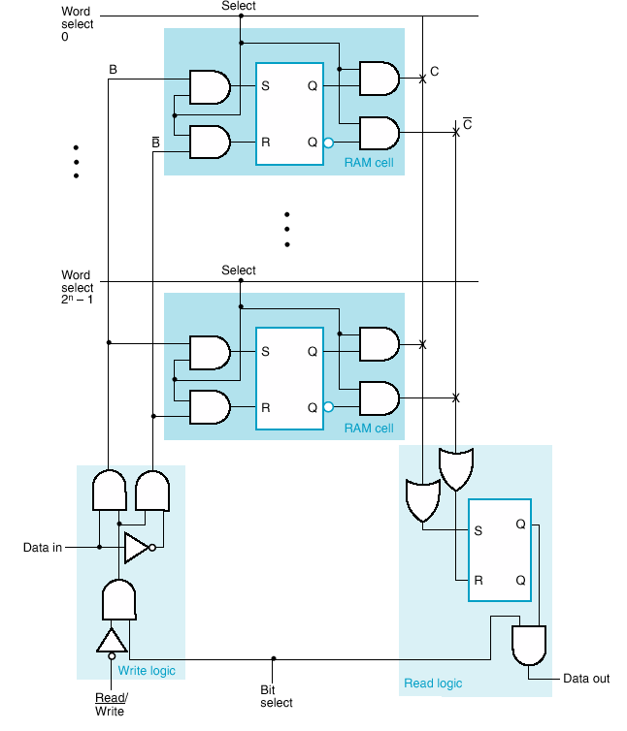
Bit Slice
Cells connected to form 1-bit position (Slice)
Word Select: selects a latch for read/write operations
B (and B’) set by R/W, Data In and BitSelect
When R/W = 0 and BitSelect = 1,
Then if Data in = 1
The latch will be set
A “1” is written

Slide 34
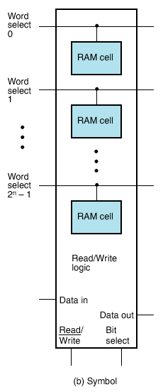
Bit Slice can Become Module
Basically a bit slice is a one dimensional array of memory
What type of hardware should we use to access one row at a time?
DECODERS!!!

Slide 35
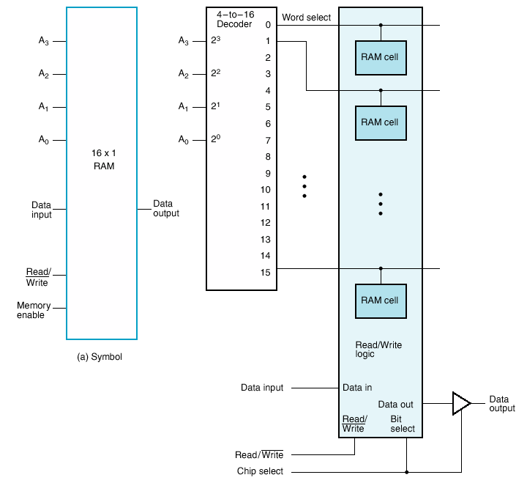
16 X 1 RAM
Remember: A (4-to-16 line decoder) → equivalent to 16 4-input AND Gates
4 address lines are required to access 16 locations.
A Decoder is added to select the different words (each 1 bit wide).
For 16 words we need a 4-to-16 line Decoder

Slide 36
Row/Column
Practical memories contains thousands of words!!
If RAM gets large, there is a huge decoder
  A 1-bit slice with 2048 locations needs 11-to-2048 Dec.
Also run into chip layout issues
How can we change the structure of Memory to solve this problem?
  Rearrange the memory into “2D” i.e., matrix layout

Slide 37
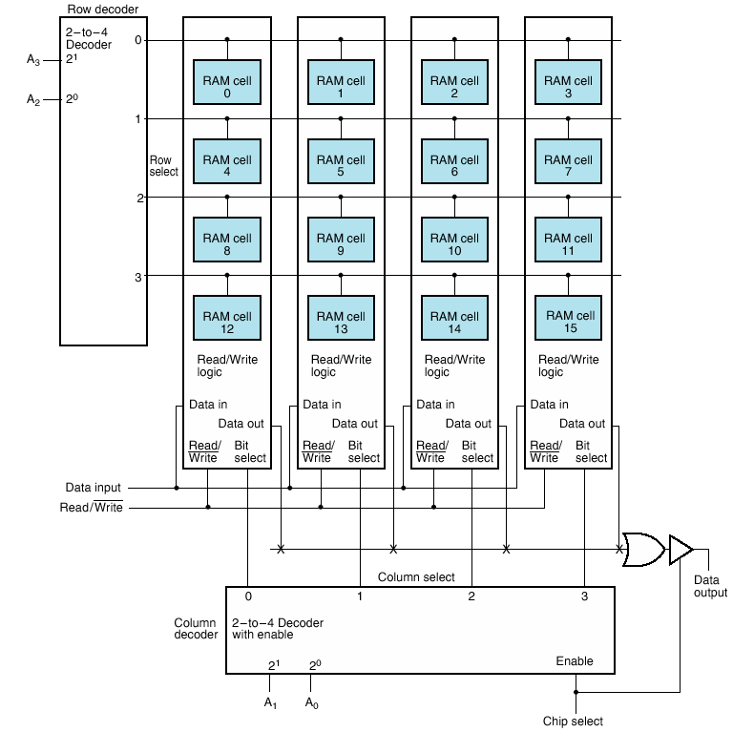
16 X 1 as 4 X 4 Array
Two (2-to-4 line Decoders) → equivalent to 8 2-input AND Gates
Two decoders
  Row
  Column
Address just broken up
Not visible from outside

Slide 38
16 X 1 as 4 X 4 Array
Employing 2 decoders instead of 1 row decoder is called coincident selection
Row Select and Column Select
A₃A₂A₁A₀=0000 will attempt to choose RAM cell 0.
One bit accessed at a time!

Slide 39
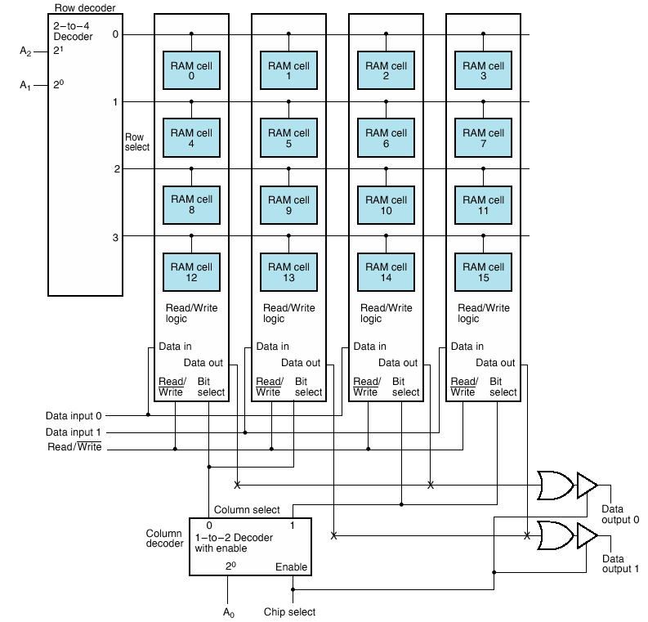
Change from 16x1 to 8 X 2 RAM
0
Minor change in logic
Try addressing 011 on board
Cells 6,7 are chosen for reading or writing.
1
Cell 6 Contents
Cell 7 Contents
1

Slide 40
Coincident Selection: Example
Imagine a 32k x 8 = ((32 x 1024) x 8) = 32,768 x 8
  262,144 bits →256K bit memory
How many address lines required to locate 32K locations (32,768)?
  Log₂ (32,768) → 15
  A 15-bit address line is required.
262,144/8 = 32,768 chunks each 8-bits
One column layout would need a decoder with 32,768 outputs
  For a single decoder that would mean 32,800 AND gates
  This is not practical!
Solution?
Coincident selection.
262,144 bits
15-to-32768
15 Address Lines
Decoder

Slide 41
Coincident Selection: Example
A 32K X 8 contains 256 Kbits (32 x 1024 x 8 = 262,144 bits)
To make the number of rows and columns equal we take the square root of 256K, giving 512 = 2⁹
  A 9-to-512 decoder is required for the rows (9 address lines are fed to the Row Decoder).
  Remember we need 8 bits of output!! (Column Decoder?)
For the columns 512/8 = 64 = 2⁶
  A 6-to-64 decoder is required for the columns (6 address lines are fed to the Column Decoder).
Total number of gates is now 512+64 = 576 AND gates
Recall without coincident selection we required a decoder with 32,800 AND gates
Thus reducing the total gate count by more than 50x.
262,144 bits
9-to-512
512
9 Address Lines
512
6-to-64
6 Address Lines

Slide 42
SRAM Performance
Current SRAMs have cycle times in low nanoseconds (say 2.5ns)
Used as cache (typically on-chip or off-chip secondary cache) to speedup access.
Sizes up to 256 Mbit or so for fast chips

Slide 43
Summary
RAMs with different characteristics
  For different purposes
Static RAM
  Simple to use, small, expensive
  Fast, used for cache
Dynamic RAM
  Complex to interface, largest, cheap
  Needs periodic refresh
  Dense, slow, used in Main Memory

Slide 44
Links
Ram:
  https://www.youtube.com/watch?v=PVad0c2cljo
  http://arstechnica.com/paedia/storage.html
  https://www.youtube.com/watch?v=0rNEtAz3wJQ
  https://www.youtube.com/watch?v=yi0FhRqDJfo
  http://islab.soe.uoguelph.ca/sareibi/TEACHING_dr/ENG241_html_dr/outline_FALL_20xx/links.html

Slide 45
Lecture End

